Slide 1


Map Reduce Framework By Priti Bhardwaj, Cdac Noida

Slide 2

Where map reduce is used?

Slide 3
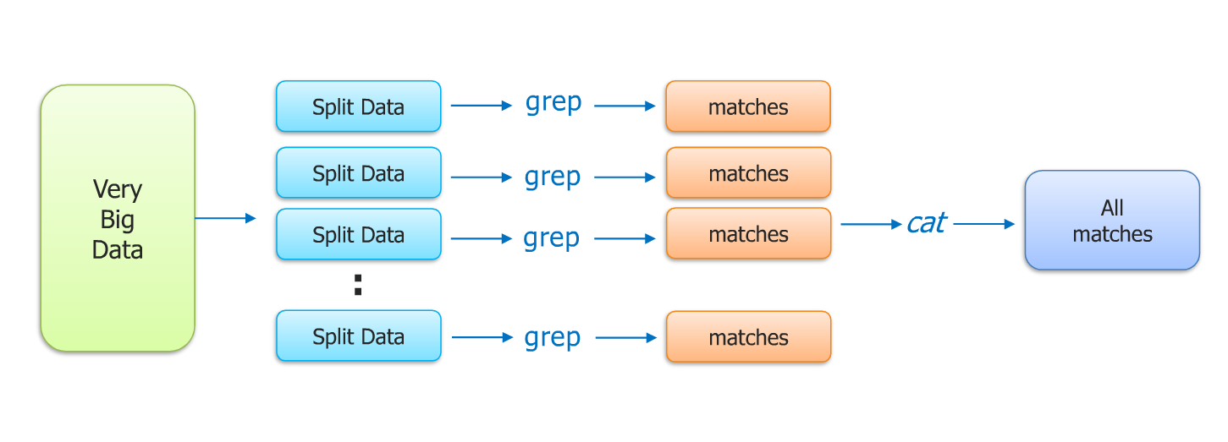
The Traditional way

Slide 4
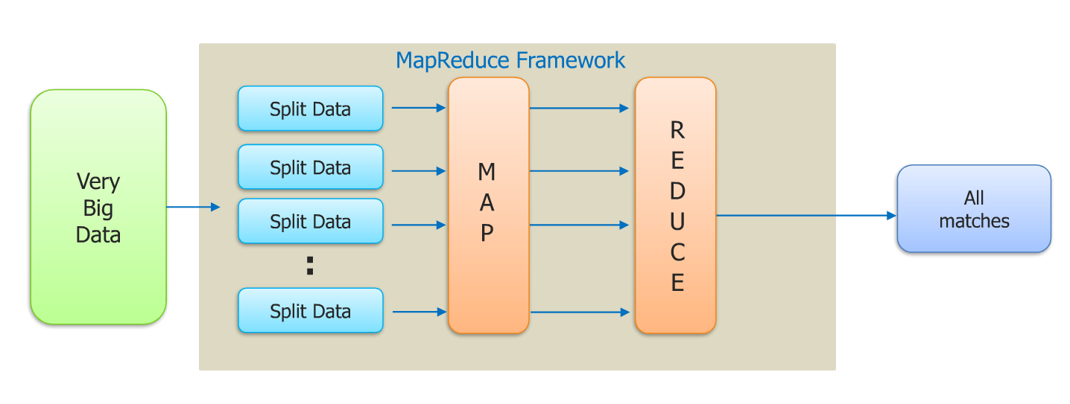
Map Reduce way

Slide 5
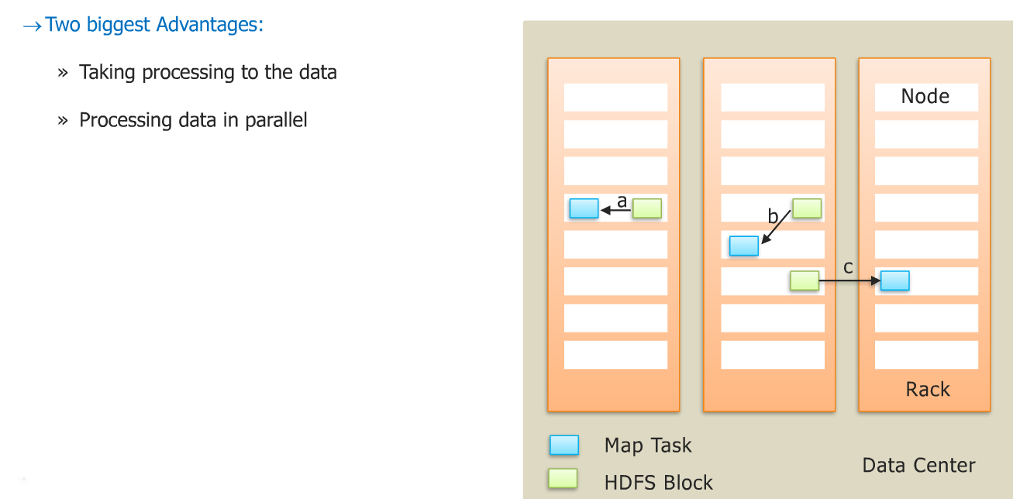
Why MAP REDUCE

Slide 6
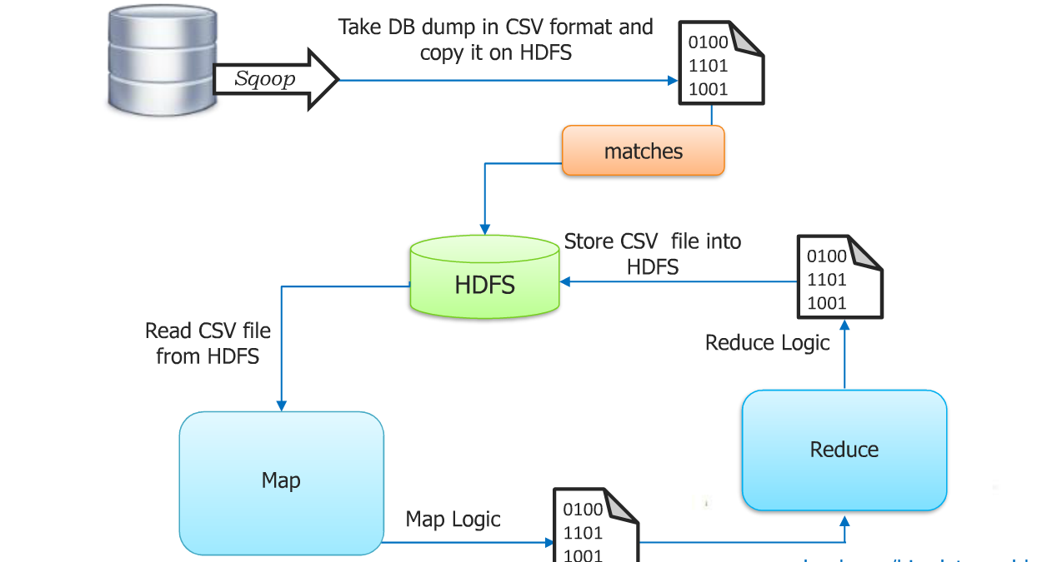
Solving the problem with map reduce

Slide 7
CSV= comma separated variable data

Slide 8
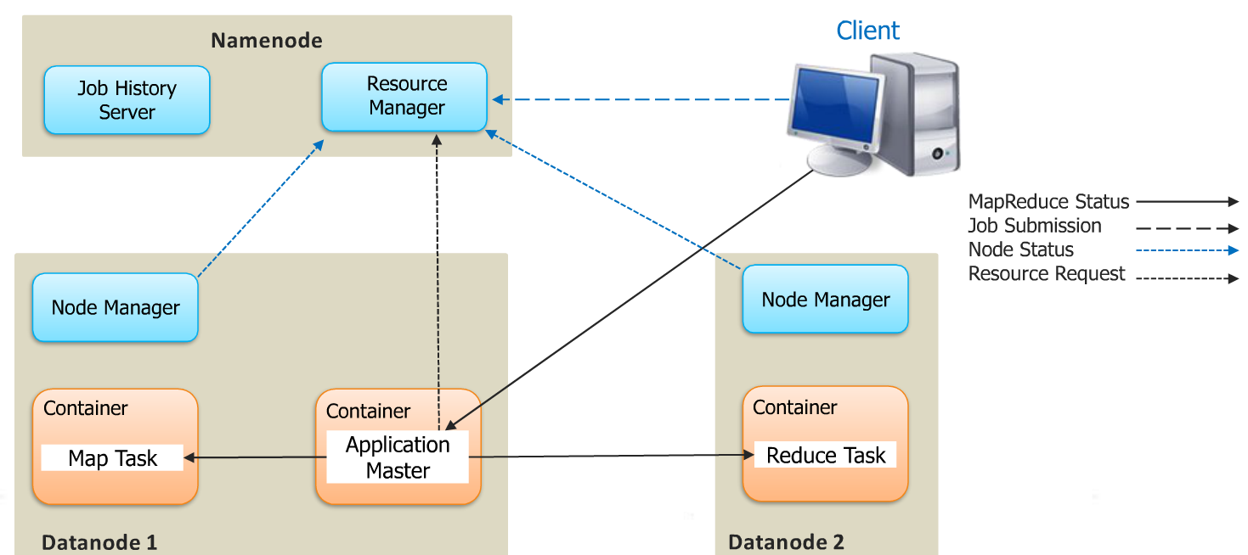
Hadoop 2.x map reduce architecture

Slide 9
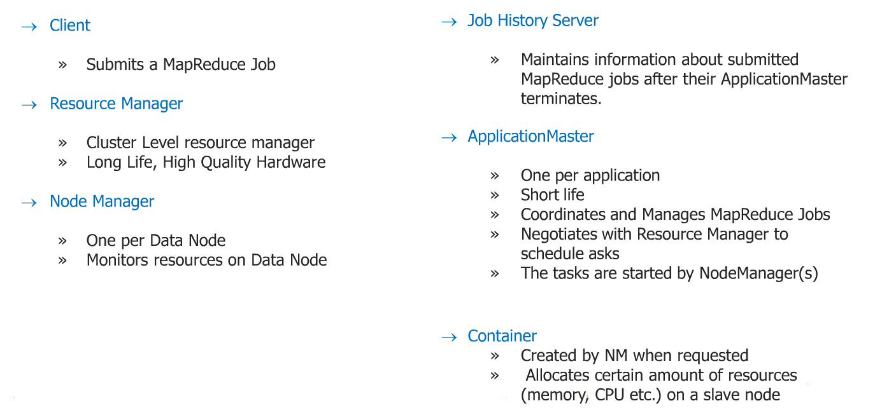
Hadoop 2.x map reduce components

Slide 10
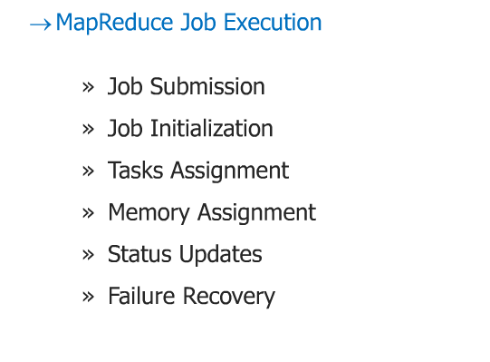
YARN Map reduce application execution flow

Slide 11
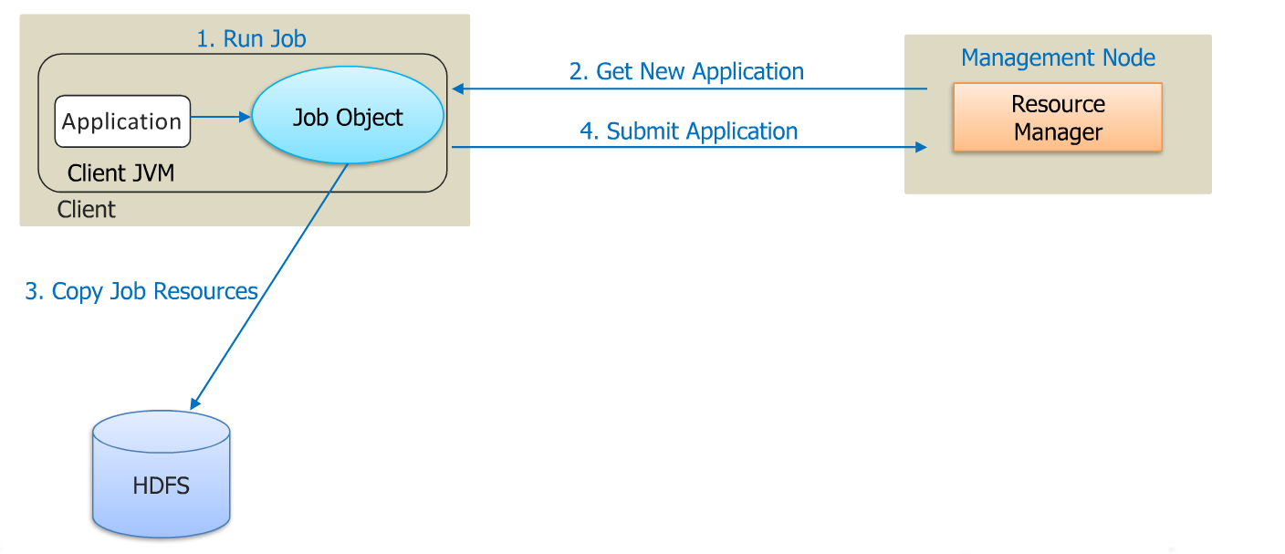

Slide 12
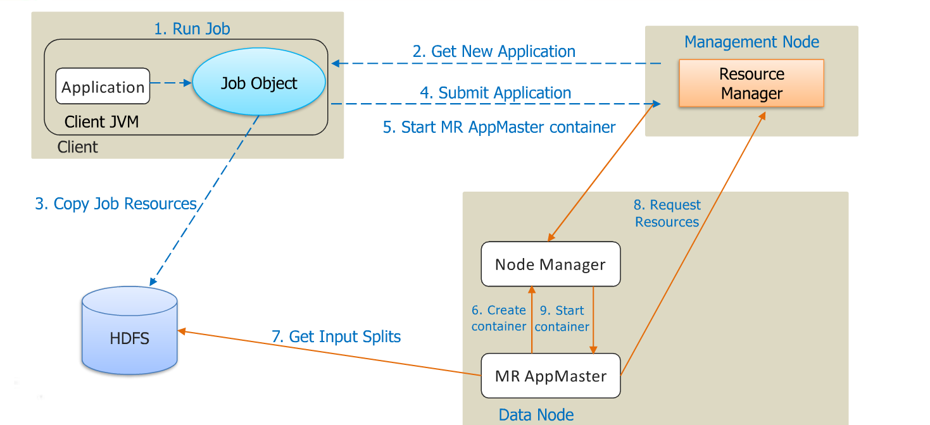

Slide 13
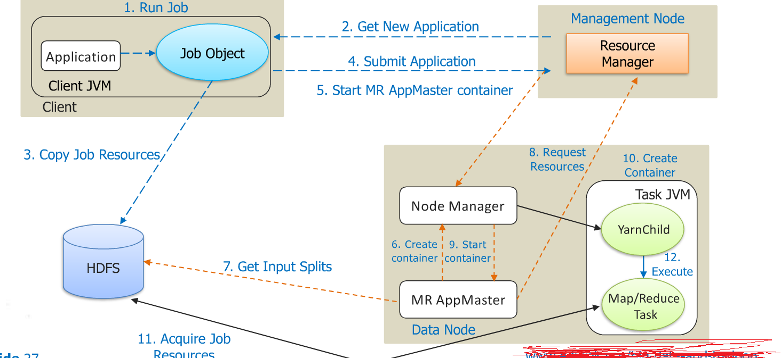

Slide 14
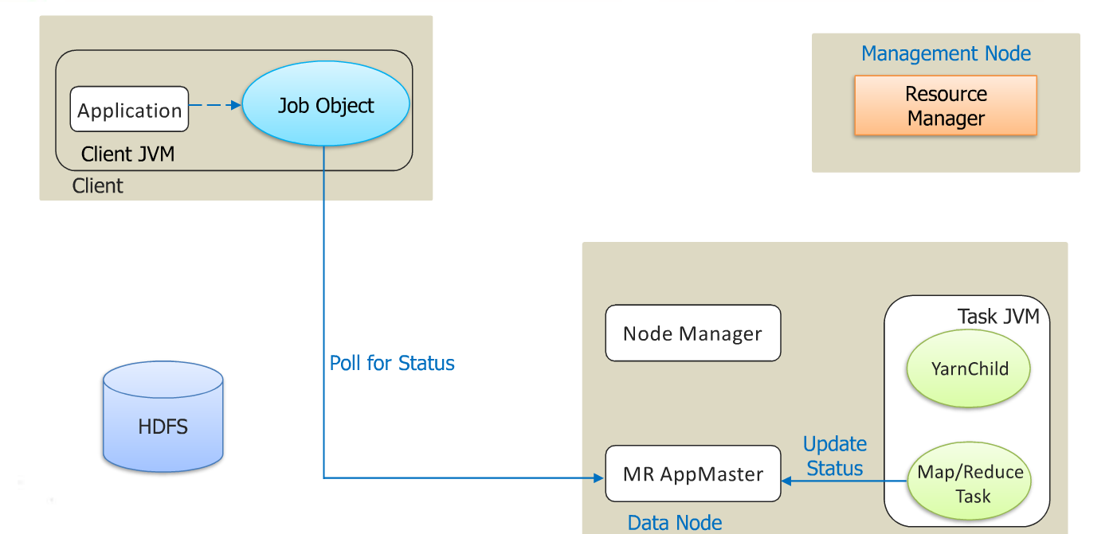

Slide 15
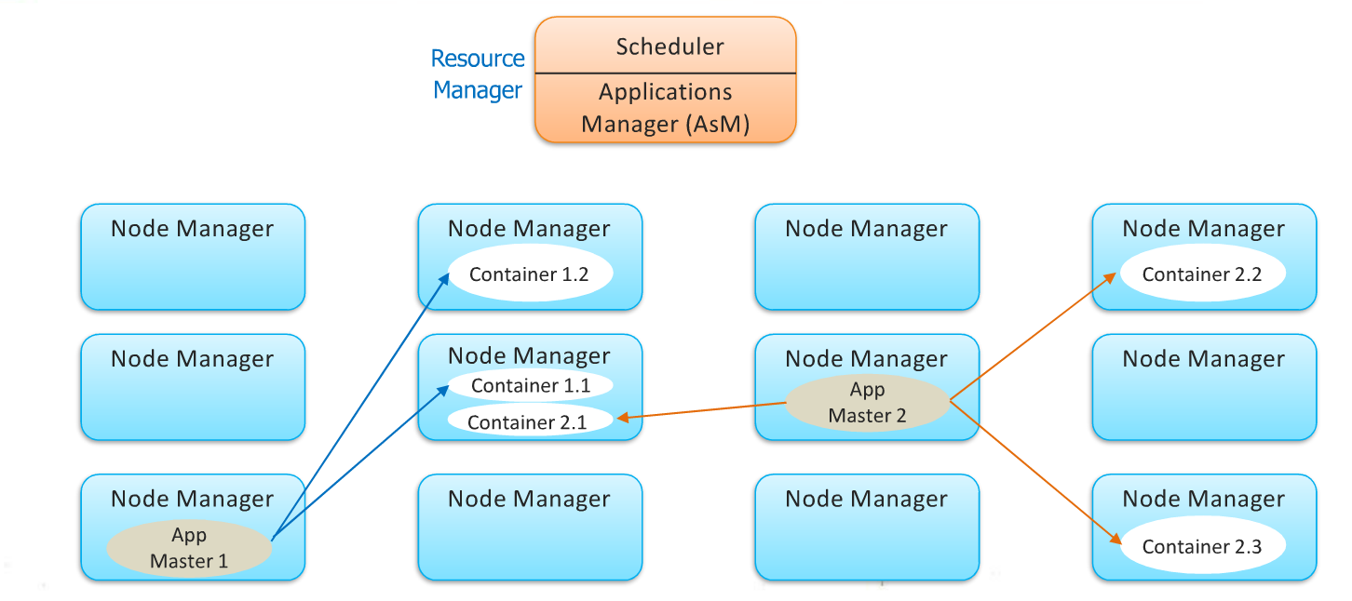
Hadoop 2.x:yarn workflow

Slide 16
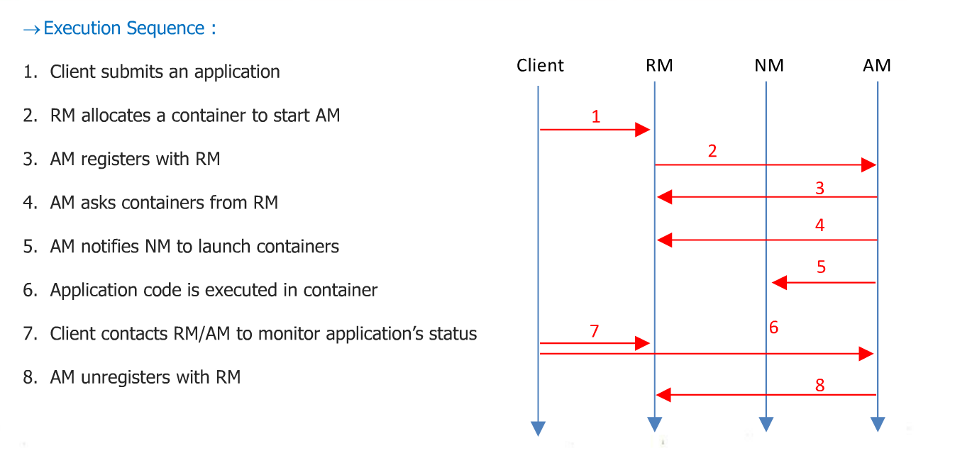
Summary: application workflow

Slide 17
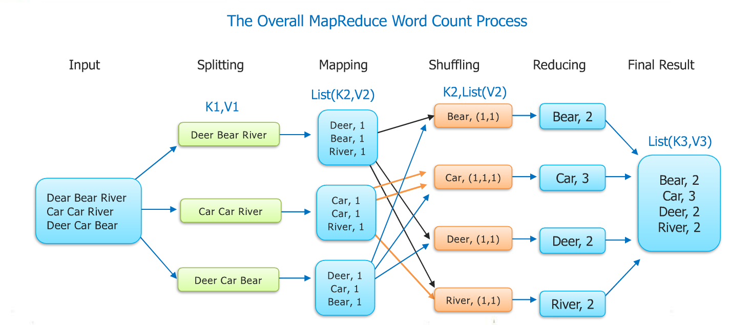
Map reduce paradigm

Slide 18
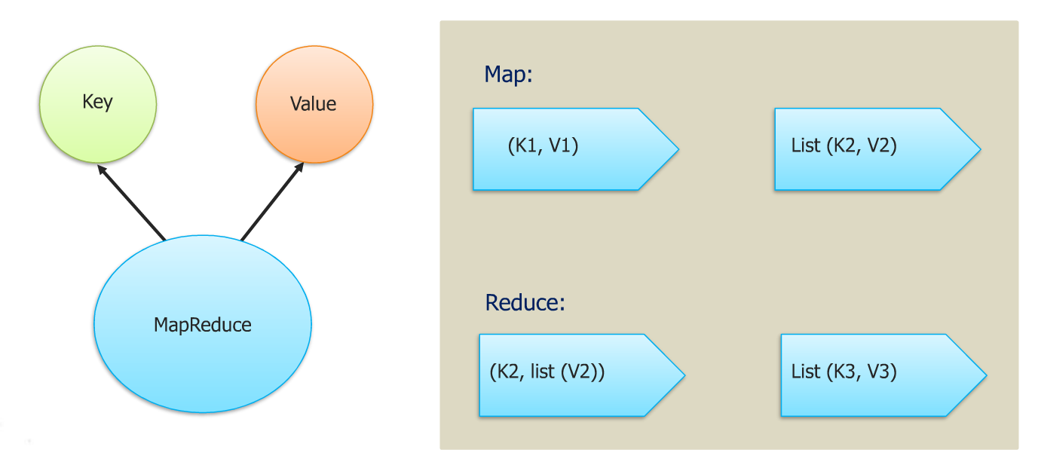
Anatomy of map reduce program

Slide 19
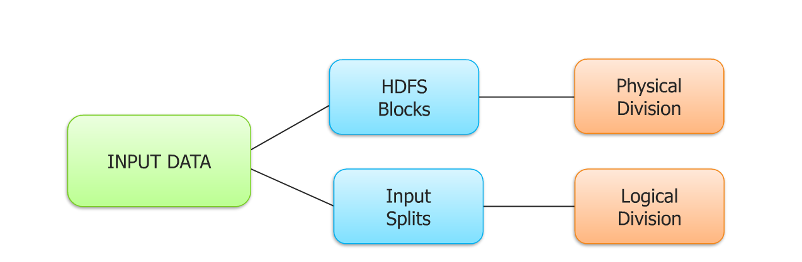
Input splits

Slide 20
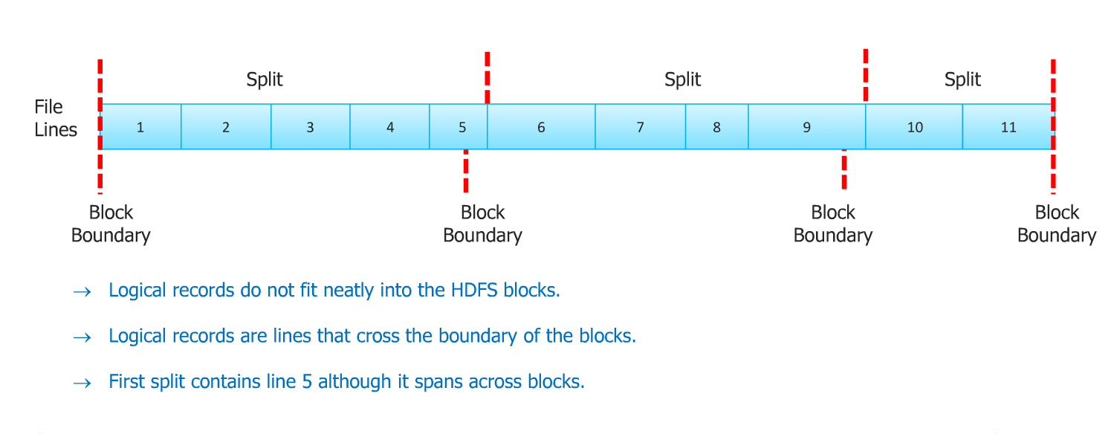
Relation between input splits and HDFS blocks

Slide 21
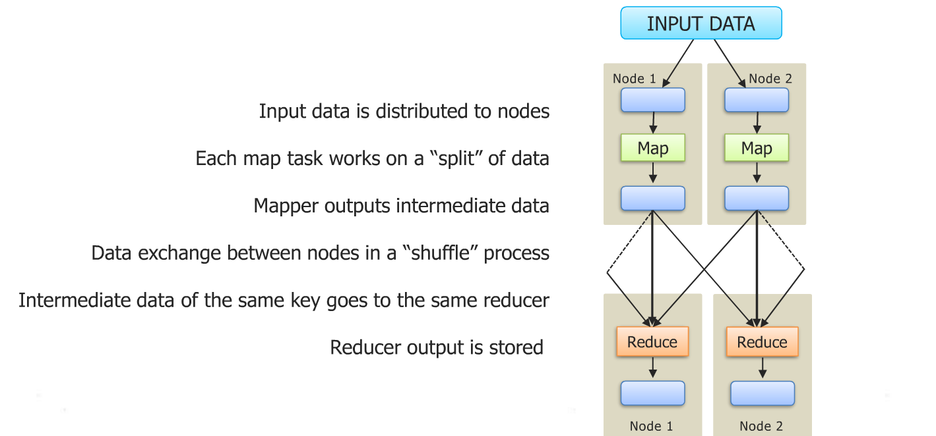
Map reduce job submission flow

Slide 22
Thank You

